Slide 1
Generating Fakenews dataset with Blockchain
Pham Do Minh Quang - 1902021

Slide 2
Fake news
Huge volume
Easy to create
Serious consequence to large group of people

Slide 3
83%
Get news from Online (incl. social media) in Singapore

Slide 4
Detection methods

Slide 5
Fact-checking by Experts
GOOD
Yield high accuracy
BAD
Expensive
Limited manpower as compare to Fake news scale
International Fact-checking network (IFCN)

Slide 6
Crowdsource
GOOD
Decent result (if instruction given)
Affordable
Bigger scale
BAD
Unreliable
Human factors (bias, distracted)
Spammers
Amazon Mechanical Turk

Slide 7
Artificial Intelligence
GOOD
Fast,
Consistent
Diversity of background
BAD
Lack of labeled dataset
Require money and time to train
Arguably the best Fake news detection method

Slide 8


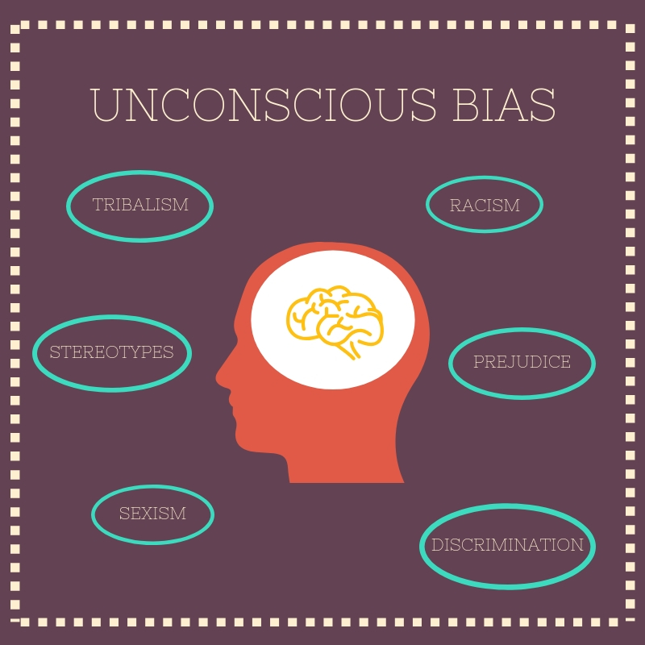
Issues of NLP dataset
Difficult to annotate
Diversity of topics
Biases

Slide 9
Solution

Slide 10

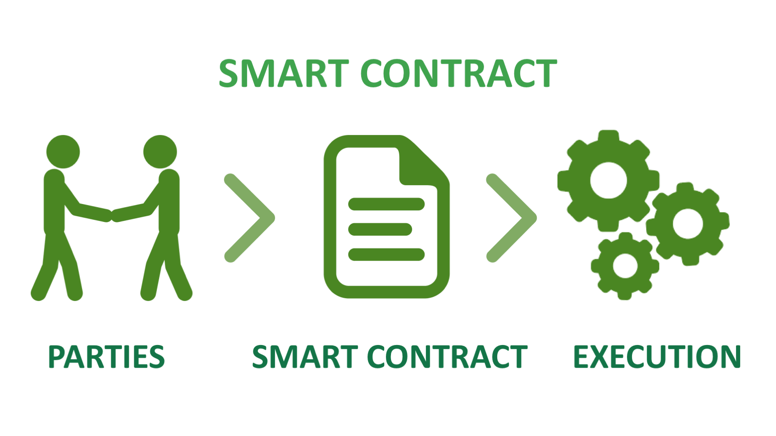
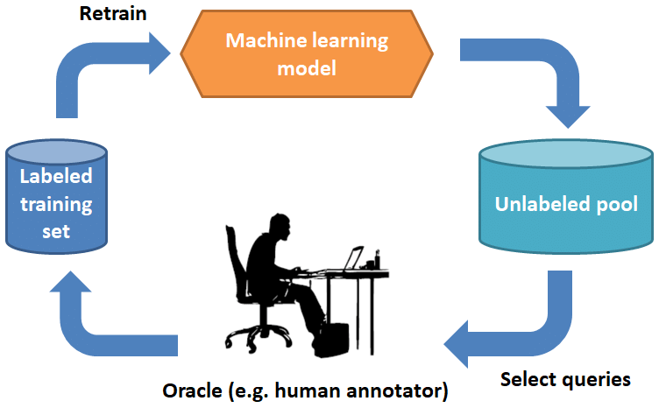
Solution aims to
Better payment system
Incentivise annotators
&
prevent spammers
Select data for annotation smartly

Slide 11
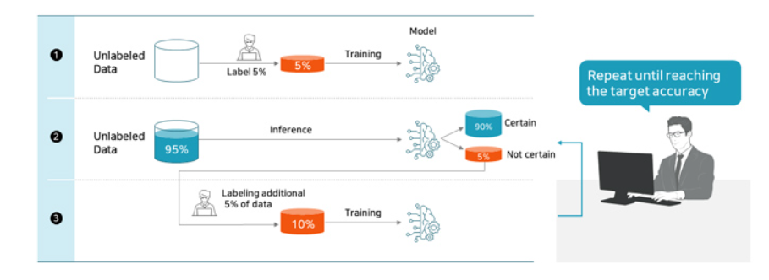
Active learning
Confidence score (Softmax)

Slide 12
Ethereum Blockchain enables crowdsourcing
NO middleman issue
Peer to Peer
NO working day
Automate by smart contract
Low transaction fee
Paypal (4.4% per transaction)
Ethereum ($0.7637)

Slide 13
Spammer
Bots or humans randomly or semi-randomly completing tasks

Slide 14
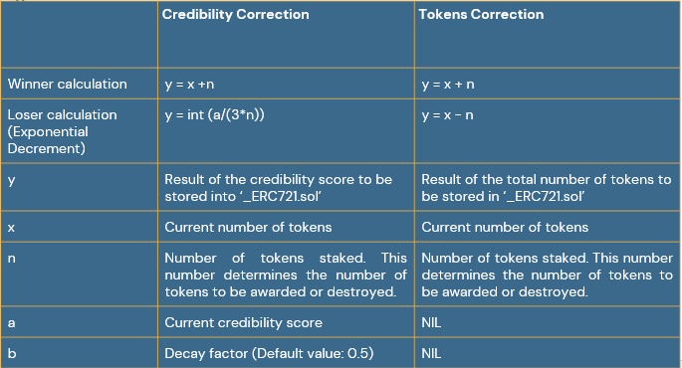

Slide 15
Flow of executions (Vote, Reward)

Slide 16
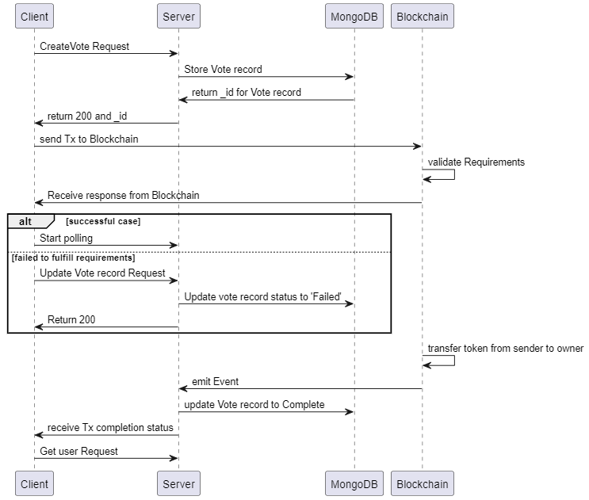

Slide 17
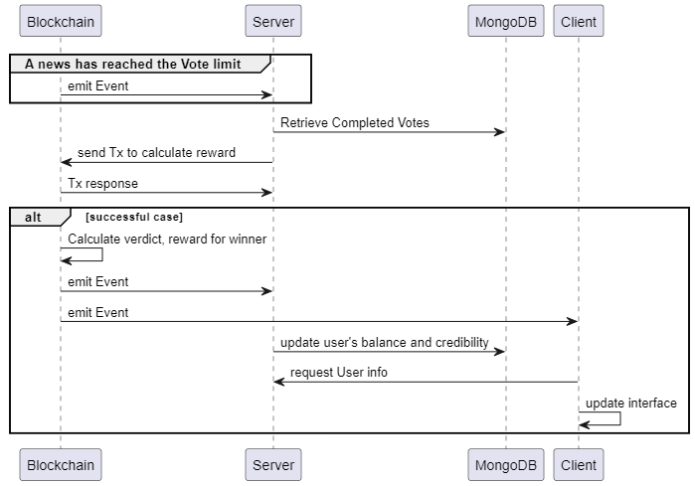

Slide 18
Demo

